Slide 1
Jane Street Market Data
Robert Carter

Slide 2
The Data
This Data Comes from a Kaggle Competition
Data Provided by Jane Street
Jane Street is a quantitative trading firm that uses machine learning for Stock trading

Slide 3
Data Continued
Data we are using: Train file
Train Table has over 2 million rows of data with over 130 columns of anonymized features

Slide 4
Objective
Establish model that can predict when to sell stock.
Will use machine learning for Modeling
R is the tool used
Focusing on Linear and Logistic Regression Modeling

Slide 5
Hypothesis
H0: Resp is over 0.5 trade
H1: If Resp is not over 0.5 do not trade

Slide 6



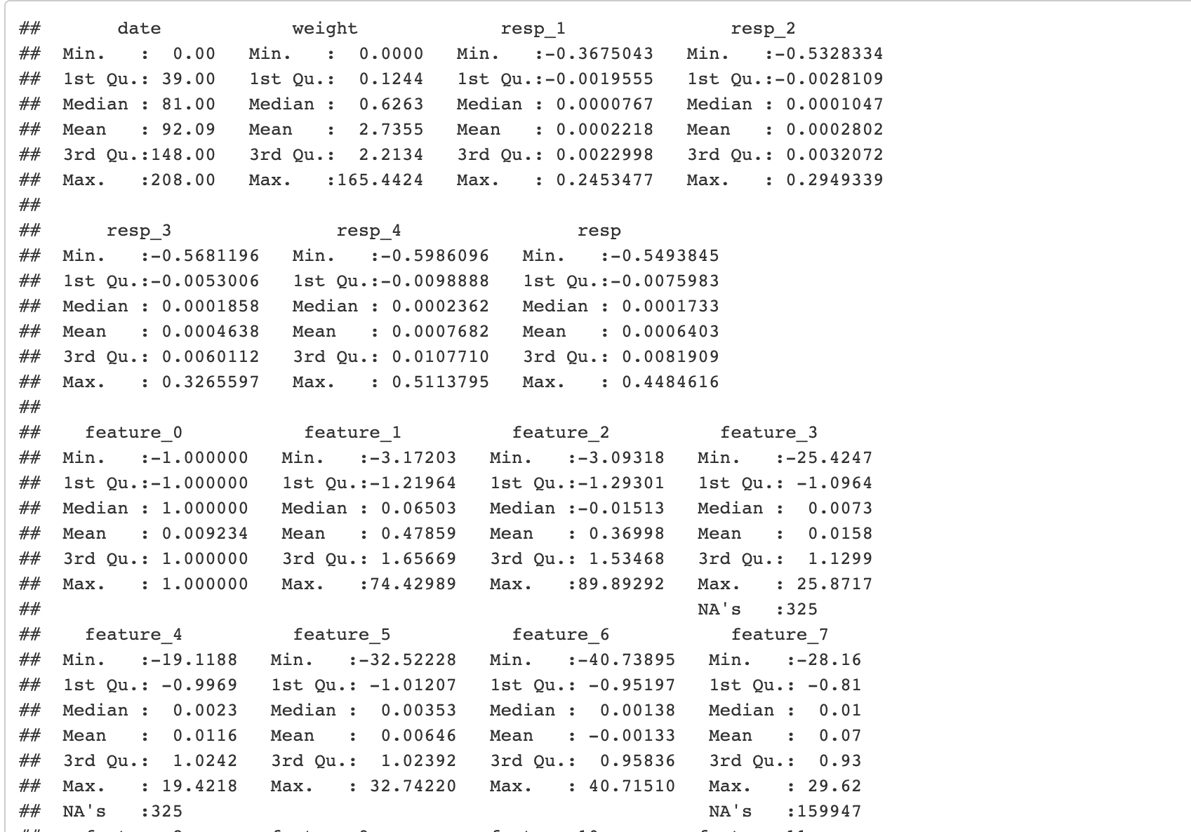
EDA – Exploratory Data Analysis
Cut data in half to help with computing power.
Initial analysis summary was ran to look at the first 5 records of each row.
At quick glance, the column we are predicting has both negative and positive
Weight has zero
Median date is 81 days

Slide 7
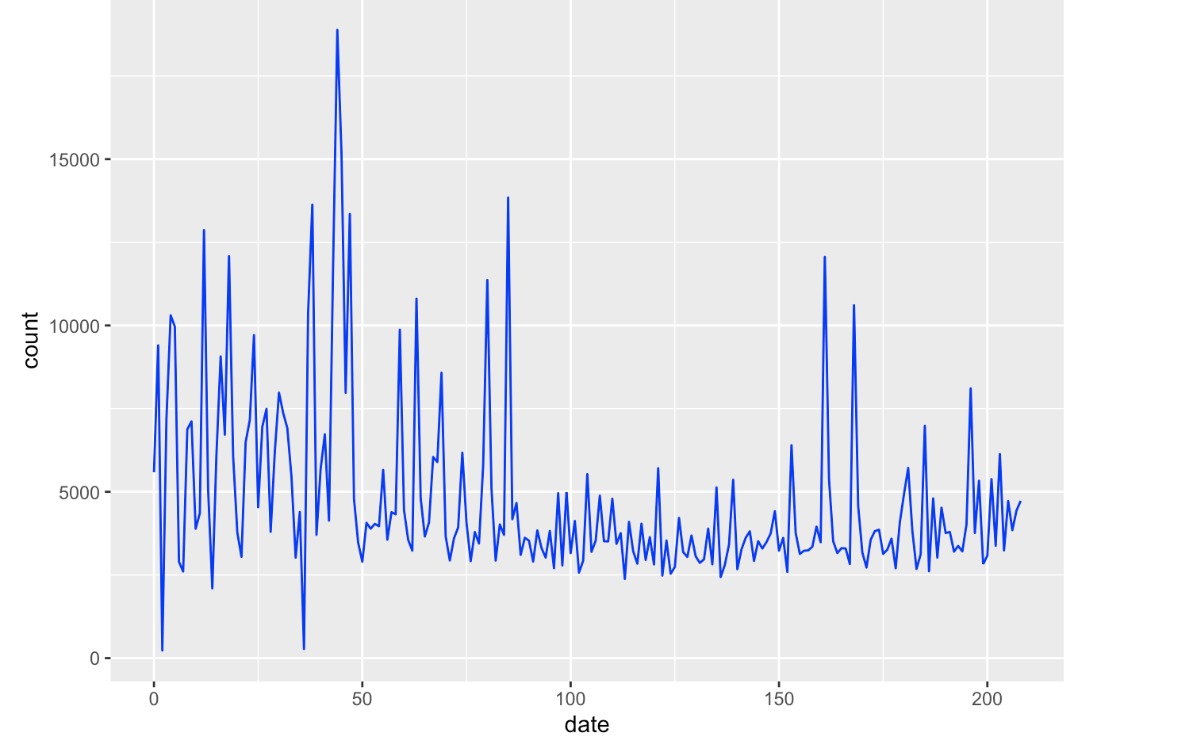
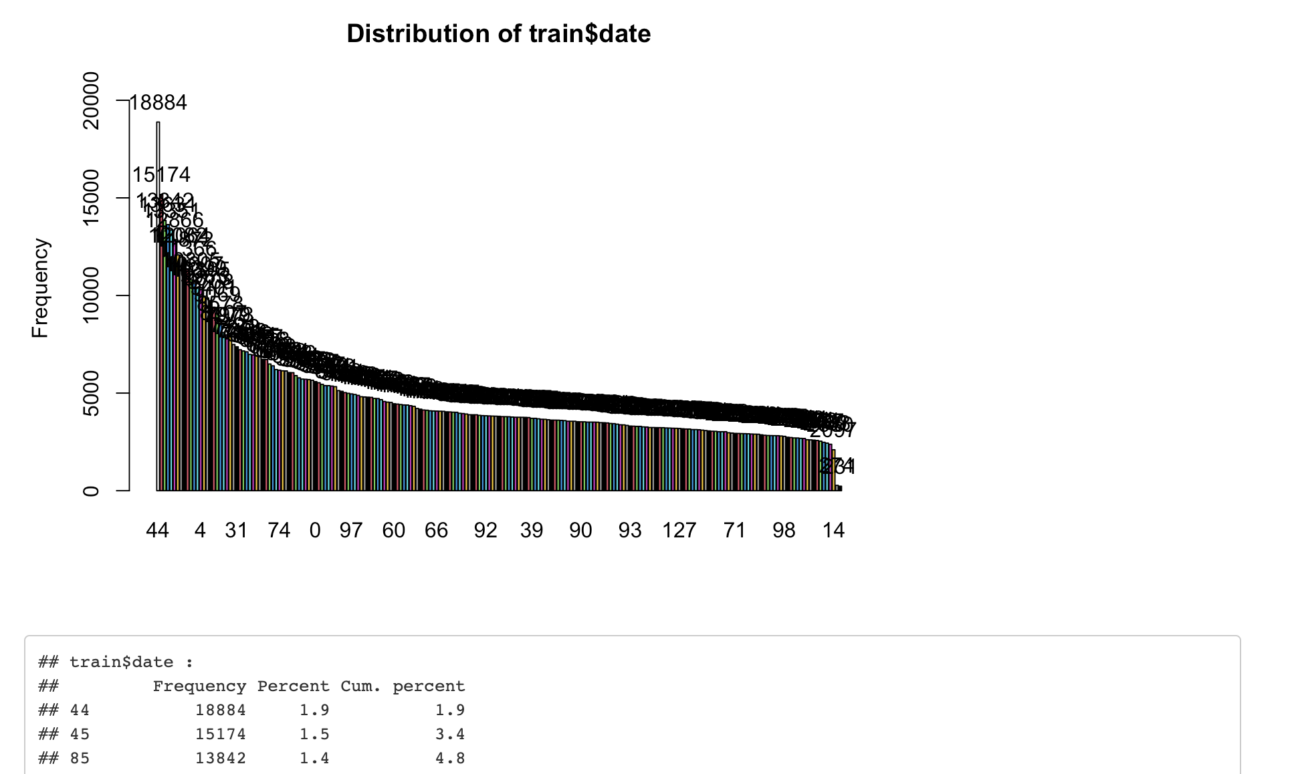
EDA Continued
There are a lot of trades that happen close to day 50.
Upon further analysis day 44 and day 45 appear to be best activity days

Slide 8
Prepping Data For Logistic Regression
Only going to look at Resp variable and Feature variable
Split data into test and training data sets and scale the data to standardize.
Put Resp into 1 or 0 for Logistic Regression analysis

Slide 9
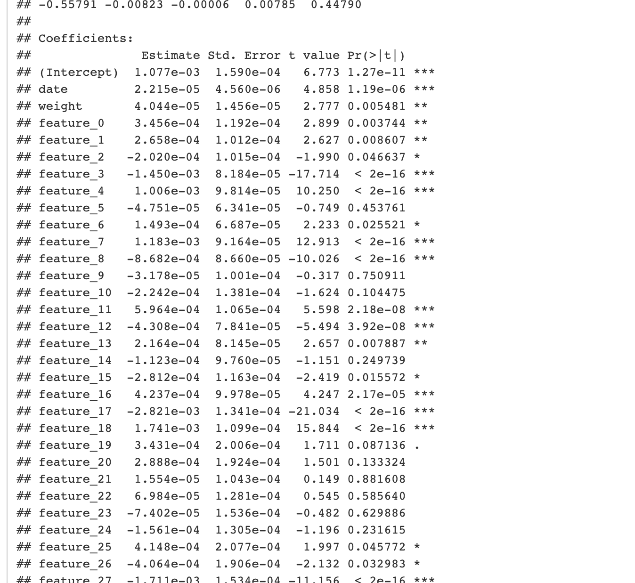
Linear Regression
First, ran linear regression on main data
Take a look at the significant fields to see if they compare to logistic regression

Slide 10
Logistic Regression
Logistic Regression better serve needs since data is not linear
Data is binary
Better for accuracy

Slide 11
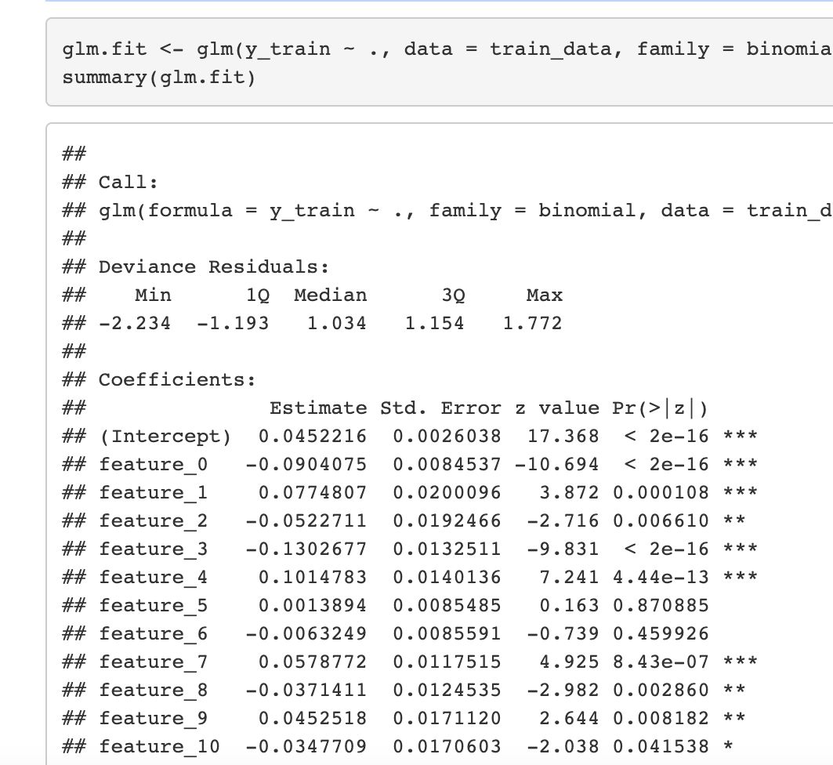
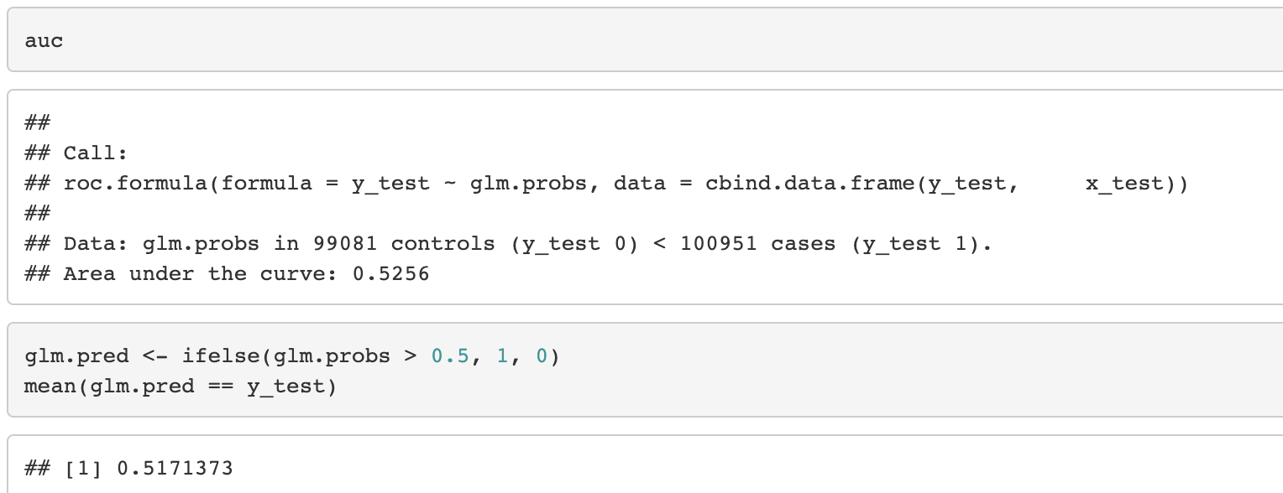
Results
Split into Train and Test
Over 40 Significant variables
Once model was trained applied test data
AUC Test .53 - acceptable
51% accuracy

Slide 12
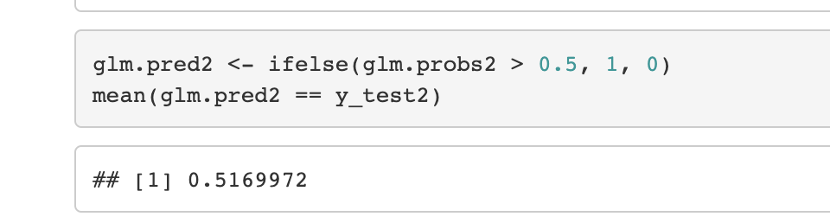
Results Round 2
Ran the same test but with only significant variables from initial run
Unsuccessful, accuracy decreased

Slide 13
Conclusion
Logistic Regression is better than Linear regression because data is not linear
I was able to accurately predict trade 51% of the time
Biggest lesson learned was understanding the data is key to a good analysis

Slide 14
Appendix
Kaggle Data: https://www.kaggle.com/c/jane-street-market-prediction/data
https://www.kaggle.com/marketneutral/target-engineering-cv-fast-ai-multi-target
https://www.kaggle.com/skybox/simple-eda-r
https://www.kaggle.com/jasenmackie/eda-logistic-torch-r

